Slide 1



Web and Internet
Class VI
lab 9

Slide 2
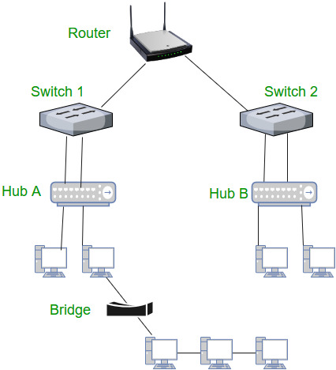
Network Devices

Slide 3
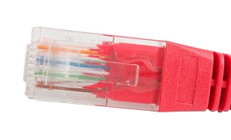
RJ45 Connector
RJ45 connector is an 8-pin jack physically connect to Ethernet based local area networks

Slide 4
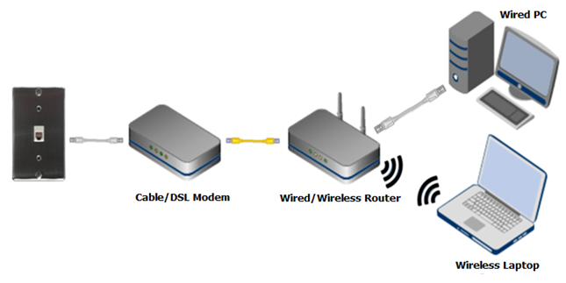
Modem
Modem is a device that enables a computer to send or receive data over telephone or cable lines

Slide 5
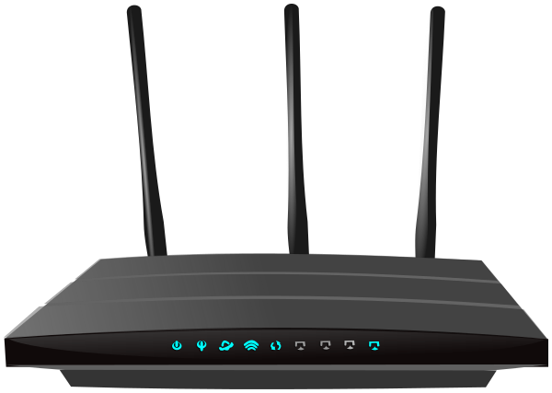
Router
A router is a network layer hardware device that transmits data from one LAN to another if both networks support the same set of protocols

Slide 6
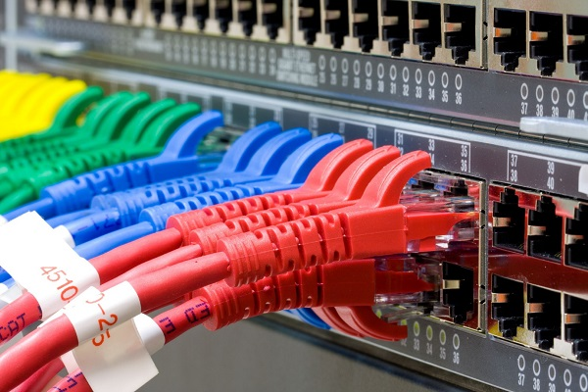
Switch
device that connects other devices to Ethernet networks through twisted pair cables

Slide 7


